Slide 1

Sprint Review
Dev Naganoolil, Muhammad Zaharudin, Muhammad Zuhaimi, Aryan Mainkar

Slide 2

What We Did
Continue on Web App
React
Leaflet Api
Covid 19 Tracking
Finished ADS

Slide 3
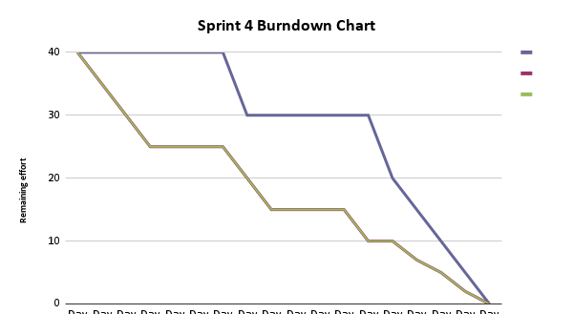

Slide 4

During Break
Create foundational Basis for Web App
Work on Data Analysis / Trends
Find More Data to Work On

